Slide 1
Railway Management System

Slide 2
OverView
This project explores concepts of Database Management and uses Procedural Language/ Structured Query Language (PL/SQL) to implement managerial functions related to maintaining passenger records, and other railway related manipulations.
It is mainly aimed to be of use for Administration/Management purposes.

Slide 3
ER-DIAGRAM

Slide 4
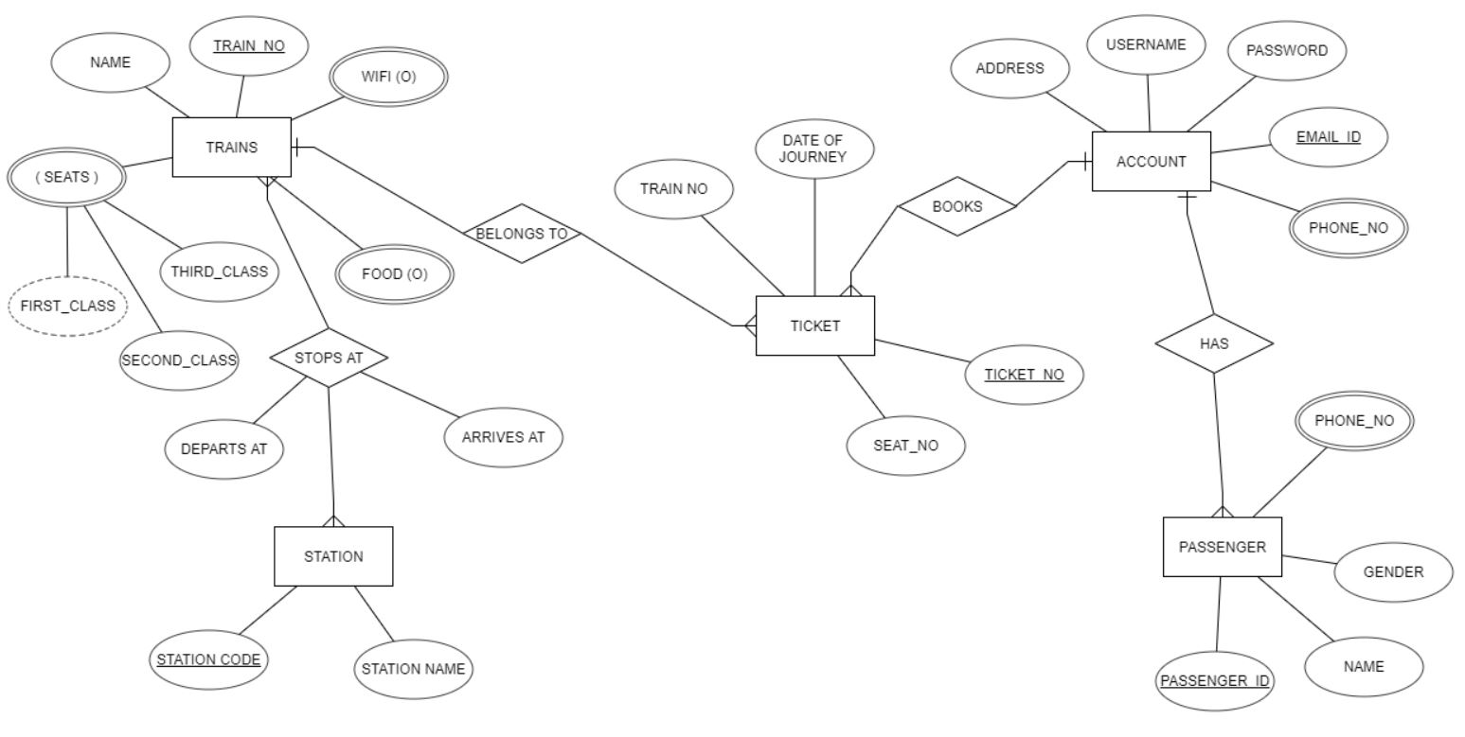

Slide 5
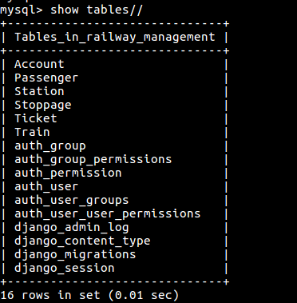
LIST OF TABLES

Slide 6
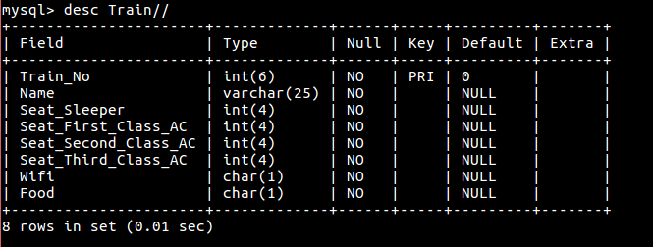
Table Train

Slide 7
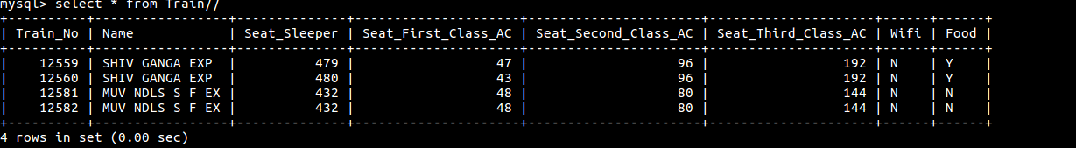
EXAMPLE-

Slide 8
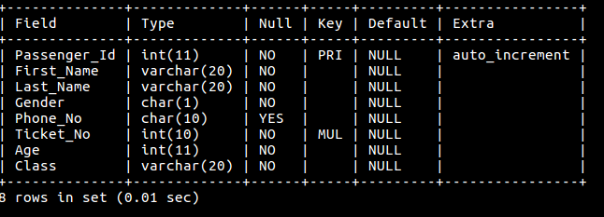
Table Passenger

Slide 9
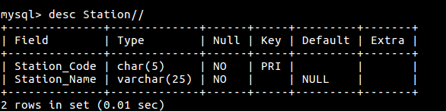
Table Station

Slide 10
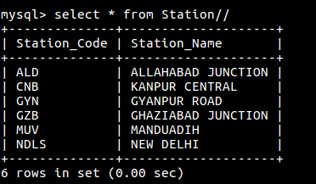
EXAMPLE-

Slide 11
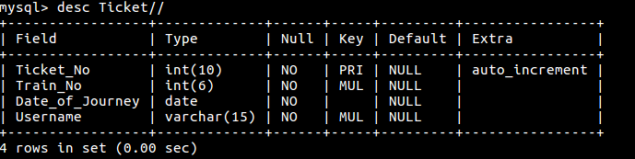
Table Ticket

Slide 12
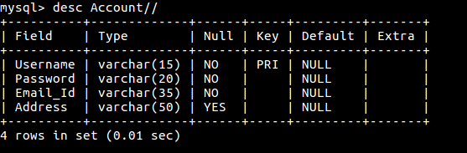
Table Account

Slide 13
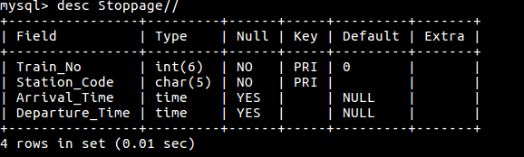
Table Stoppage

Slide 14
LIST OF PROCEDURES
PROCEDURE TO CHECK FOOD
PROCEDURE TO CHECK FOR SEATS
PROCEDURE TO LOOK FOR STATIONS WITH “ “

Slide 15
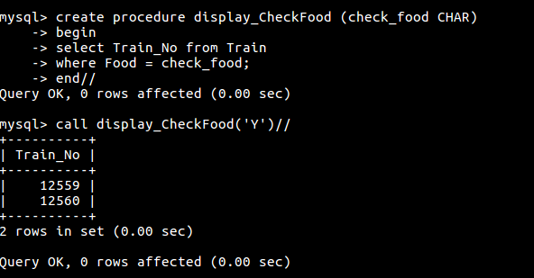
PROCEDURE TO CHECK FOOD

Slide 16
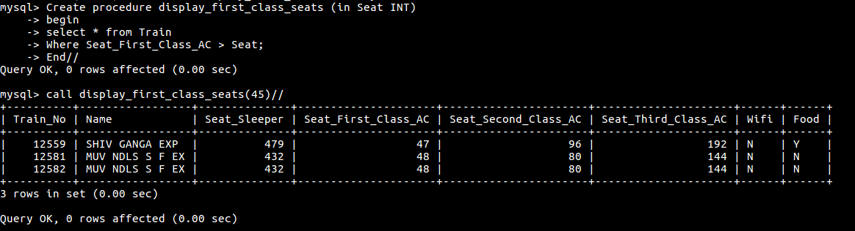
PROCEDURE TO CHECK FOR SEATS

Slide 17
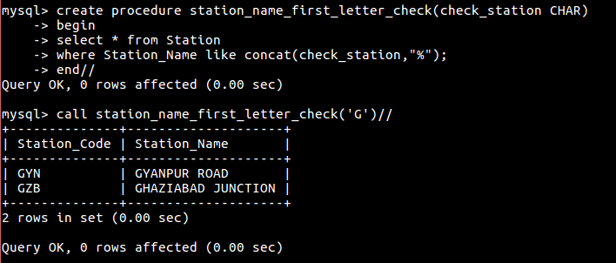
PROCEDURE TO LOOK FOR STATIONS WITH “ “

Slide 18
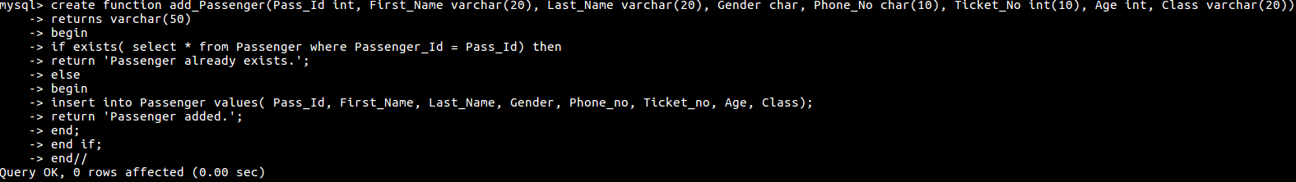
FUNCTIONS

Slide 19
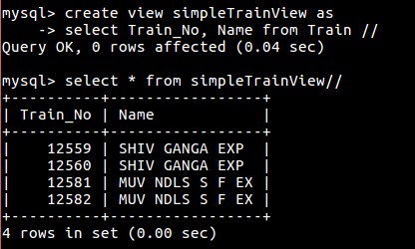
VIEWS

Slide 20
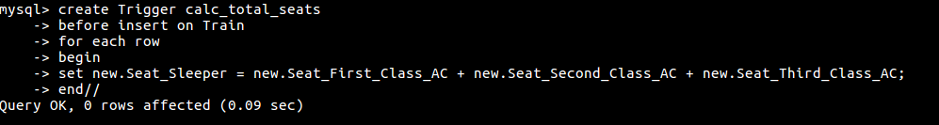
TRIGGER

Slide 21
THANKS!!

